Slide 1

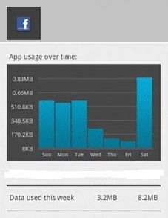
Mobile Packet Monitor
User Interface
By Josue Martins
Supervisor Dr. W.B Tucker
& Co-Supervisor Mr. M. Norman
Notes:
Spell out UI as User Interface using a 2nd line
Practice to get the timing right as you only have 6 slides of which only 4 have stuff to talk about – most of your time will be spent on slides 2,3 an 4 – so make sure you speak sufficiently to these slides; don’t need to spend much time in slide 5 – just do it briefly;

Slide 2
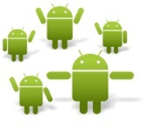

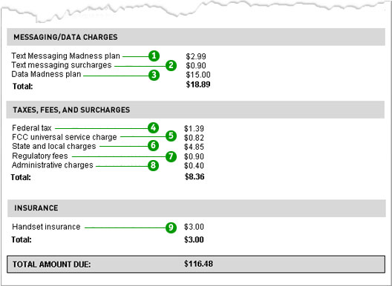
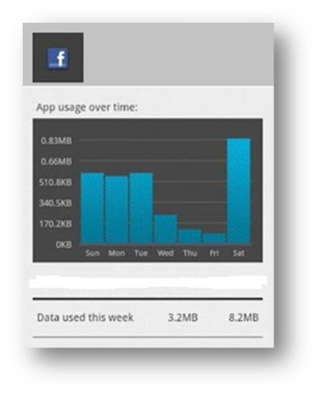
Introduction
What is an Mobile Packet Monitor software?
Will monitor the data usage on your mobile.
It will store the information about the data used and present to the user in organized manner.
This will help Mobile users make a well informed decision about the data usage on the Mobile Phone.
Why is the Mobile Packet Monitor important?
It will provide more data control.
It will provide awareness of data Usage and cost.
It will help users make better financial decisions on internet Data usage thus reducing cost of using Internet on a mobile phone.
Mobile users
Expensive Mobile phones Bills
Solution
Android packet monitor
Notes:
This Project will focus on making mobile phones reliable in terms of management of your finances while performing communicative task on your Android mobile phone,. By using the Android Packet monitor that will monitor the data usage on your mobile, storing information about the data usage and present to the user in organized manner in order to help the user make a well informed decision about the data usage on the Android Mobile Phone.
Change this paragraph into bullets rather – its basically one long sentence currently – the bullets will also guide you through the presentation talk; make sure you clearly state why your project is important/needed; mention how your project connects with the project of Mr. Malama – perhaps a new slide after this slide with a diagram showing this would be a good idea;

Slide 3
User Requirement
It should tell the user how much data he/she Uses.
It should offer options to view the summary in form of list or graph.
It should have a summary of Data Usage by application.
  Daily
  Weekly
  Monthly
It should show which application are currently using the data via GPRS, 3g and Wi-Fi.
Summary with comparison of which application is consumes less and more data.
User should have a option to specify Data plan.
The software contain notifications
  Suggesting of which software to use or not use often
  Warning of how much data is left
We should show if the data is being throttled.
Notes:
Mention where you got your requirements from – from users or supervisor or forums or from a document analysis;
This users requirements where gathered from supervisior and questionaries

Slide 5
Requirement Analysis
Simple User Interface.
Intuitive, Faster Transition time.
full Screen run time and Touch screen interaction.
Notifications.
Graphical and List Summaries features.
Spacing to display better images.
Compatibility for Android Phones running Android 2.2 Froyo OS to the Latest Versions Of Android OS.
Notes:
Spelling error – intuitive; remember requirements analysis is speaking out on one or more of the following (data seems lacking in the above slide):
user scenarios, function activities, classes (relationships), data or database, user interface
– it basically shows data/function/behaviour that satisfies the requirements. This done with a combination of text and diagrams. See Chapter 6 of the SE text book for more details

Slide 6
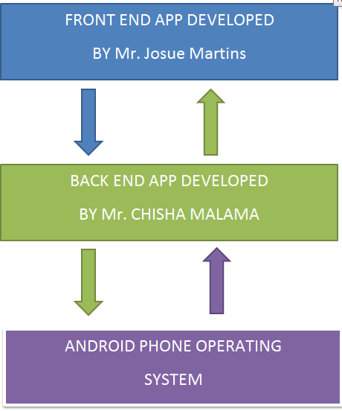
Front End integration with Back End

Slide 7
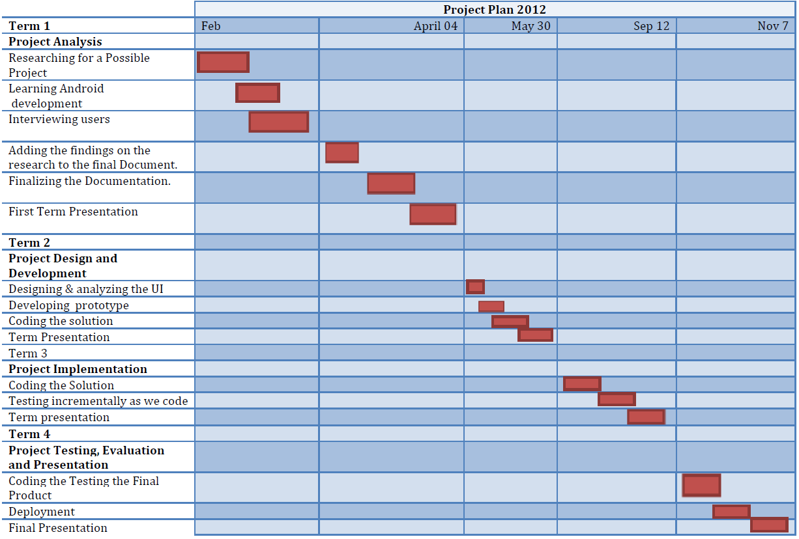

Slide 8
References
(n.d.). Retrieved from http://developer.android.com/guide/basics/what-is-android.html
Developers, A. (n.d.). Android Developers. Retrieved April 03, 2012, from http://developer.android.com/guide/basics/what-is-android.html
Huang, Y. (2009, September 14). BEGIN ANDROID JOURNEY IN HOURS. Retrieved April 03, 2011, from http://www.cs.uiuc.edu/class/fa09/cs425/mps/tutorial.pdf
Marsden, M. J. & Gary Marsden (2005). Mobile Interaction Design. In M. J. Marsden, Mobile Interaction Design (p. 5). Wiley.
Matias Duarte, R. F. , Rich Fulcher, Roman Nurik, Adam Powell & Christian Robertson(2011). Google 11 IO. Retrieved April 03, 2011, from http://static.googleusercontent.com/external_content/untrusted_dlcp/www.google.com/en//events/io/2011/static/presofiles/designing_and_implementing_android_uis_for_phones_and_tablets.pdf

Slide 9

The End
Questions?

